Slide 1
Project 5:User Analytics in the Telecommunication Industry
Gurpreet kaur
Submission Date: 24 April 2025

Slide 2
Executive Summary
This project focused on analyzing telecom user data to uncover actionable insights that support strategic decision-making in customer engagement, experience, and satisfaction. The scope of the analysis included understanding customer demographics, usage patterns, engagement trends, and satisfaction levels to identify areas for improvement and potential growth.
Datasets Used & Major Analysis Areas: The analysis was conducted using a comprehensive telecom dataset containing user demographic information, service usage logs, engagement metrics, network experience, and customer feedback. The key areas of analysis included:
Customer Overview: Segmentation by age, location, and service usage patterns.
Engagement Analysis: Frequency and duration of service use, app interaction, and user activity trends.
Experience Analytics: Network performance indicators such as download/upload speed, latency, and call drop rates.
Satisfaction Analysis: Survey-based satisfaction scores and churn prediction using behavioral and experiential data.
Final Recommendation: Growth Potential & Acquisition Suggestion The analysis revealed a significant growth potential in the younger user demographic (ages 18-35), particularly in urban regions where high engagement and positive experience metrics were observed. Moreover, clusters of high-value users were identified, showing a strong correlation between quality of experience and loyalty.
Recommendation: Invest in improving network infrastructure in semi-urban areas to match urban service quality, enhance digital engagement channels for tech-savvy users, and consider acquiring smaller regional telecom providers with overlapping high-engagement user segments to accelerate market share expansion and reduce competition.

Slide 3
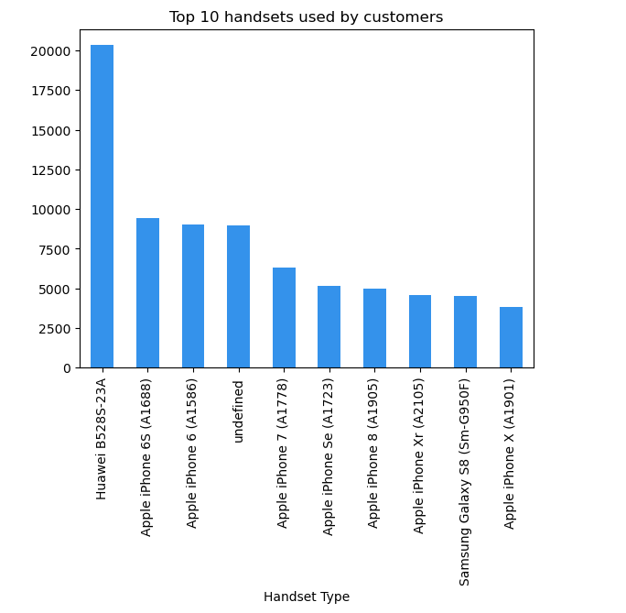
Customer Overview
Top 10 Handsets Used : The top handset brands identified included models from Apple, Samsung, Huawei being the most frequently used devices. Other popular models showed a mix of mid-range and flagship devices, indicating a diverse user base in terms of spending capacity.
Key Insight:
Model Popularity: Flagship models dominate the top ranks, suggesting high brand loyalty and device investment among users.
Marketing Opportunity: Targeted marketing campaigns and device-specific offers (e.g., data bundles or app promotions) can be optimized by focusing on users of the most popular handsets, especially iOS and high-end Android users.

Slide 4
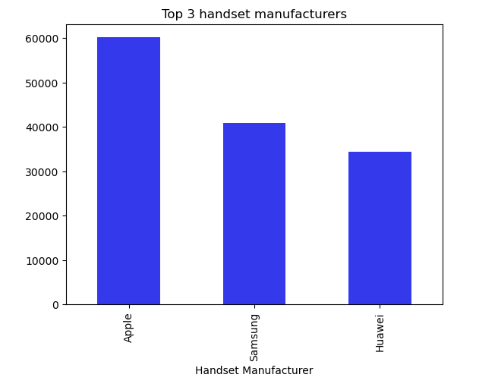
Top 3 Handset Manufacturers
The chart illustrates that the majority of users are concentrated among three major manufacturers:
Apple
Samsung
Huawei
Together, these brands account for a significant majority of all devices in use, with Apple leading the market share, followed closely by Samsung. Huawei maintains a strong presence, particularly among mid-tier users.
Key Insight:
Dominant Market Players: Apple and Samsung have the largest share, indicating a premium-oriented user base that could respond well to value-added services and loyalty programs.
Brand-Centric Strategy: Marketing and service plans can be tailored by partnering with these top manufacturers to boost user experience, retention, and brand alignment.

Slide 5
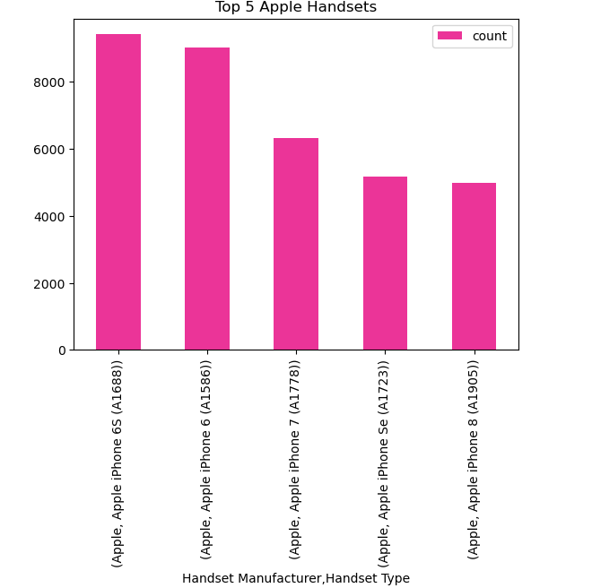
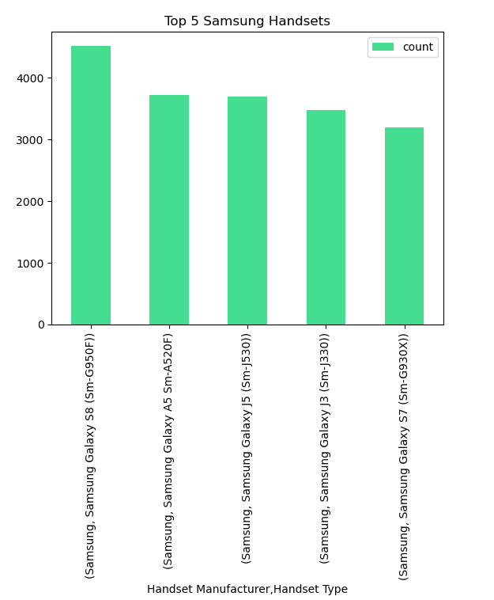
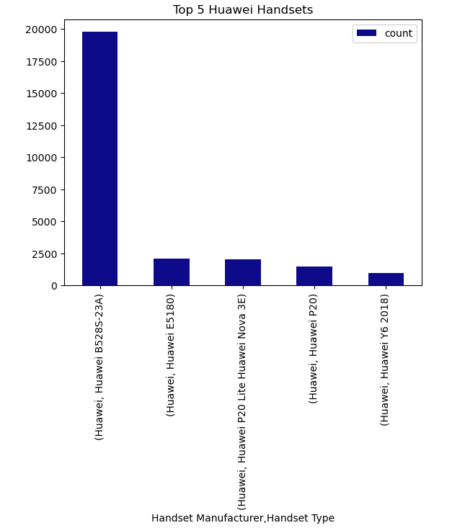
Top 5 Handsets per Top 3 Manufacturer
A grouped bar chart was used to compare the top 5 most popular handset models under each of the top 3 manufacturers — Apple, Samsung, and Huawei — to explore both brand and model-level preferences.
Key Insight:
Apple shows high concentration in a few premium models, suggesting loyalty and strong ecosystem stickiness.
Samsung users span a mix of flagship and mid-range models, showing brand versatility and appeal to a broader market.
Huawei exhibits more fragmented usage across mid-tier devices, potentially targeting cost-sensitive yet data-active users.

Slide 6
Interpretation & Recommendation
1.Samsung dominates the market followed by Apple and Huawei.
2.Their top handsets are the most frequently used, making them prime targets for partnerships.
3.Marketing teams should run campaigns aligned with top handset models to drive engagement.
4.Tailor services and offers according to device usage patterns.

Slide 7
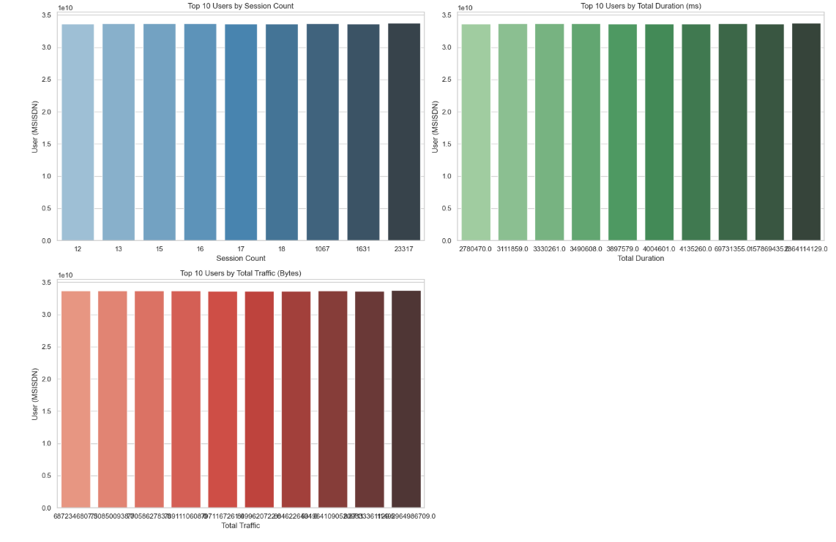
Top 10 Users by Engagement Metrics
top 10 users sorted by the following engagement metrics:
Session Frequency: How often each user interacts with the service.
Session Duration: Total time spent by the user per session.
Total Data Usage: The total amount of data consumed by each user.
Key Insight:
Power Users: These users have high engagement metrics across all three dimensions — session frequency, duration, and data usage. Identifying these power users can help prioritize retention efforts and offer them tailored.

Slide 8
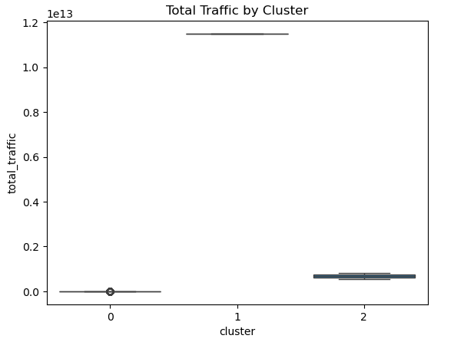
Engagement Clustering (k=3)
This boxplot displays the distribution of total traffic (data usage) for each of the 3 engagement clusters derived from KMeans clustering.
Interpretation of Each Cluster:
Cluster 0:Low total traffic users. Likely light users — minimal video streaming or large downloads. May include users with infrequent or short sessions.
Cluster 1:Extremely high total traffic. These are your heavy data consumers — possibly streamers, remote workers, or bulk downloaders. The narrow spread suggests consistent heavy usage.
Cluster 2:Moderate data usage, with some variability. This could represent average users: balanced usage across apps like social media, browsing, and occasional video.
Key Insight:
The boxplot clearly shows that Cluster 1 dominates in total traffic, even with a relatively narrow range — suggesting a distinct group of consistently high-usage users. Clusters 0 and 2, in contrast, cater to lower and mid-tier data consumers, respectively. This segmentation helps identify users for tailored data plans or promotions.

Slide 9
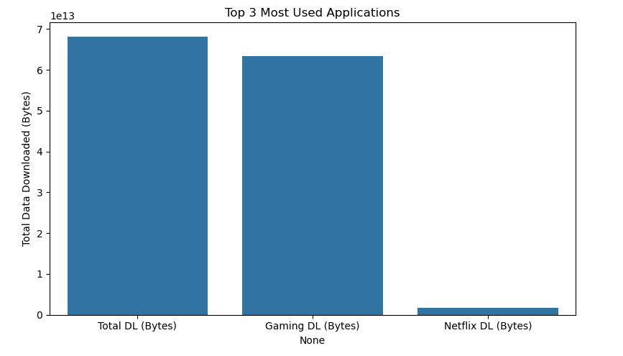
Total Traffic per Application
Bar chart showing the total traffic per application (e.g., Total DL Bytes, Gaming Dl Bytes, Netflix Dl Bytes).
Key Insight:
App Usage Pattern: The chart will illustrate which applications dominate user traffic. For example, if Total DL Bytes is the largest contributor, telecom companies can use this insight to focus on improving streaming services and promoting data plans specifically for high-usage apps.

Slide 10
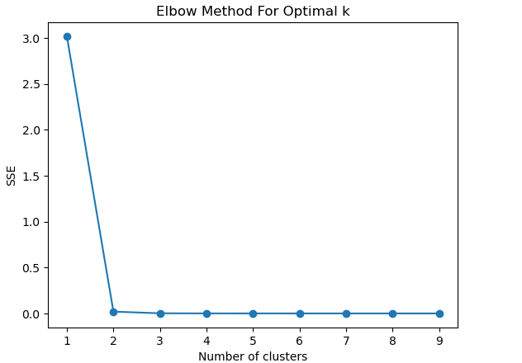
Elbow Method + K-Means Clustering
Each point represents the total intra-cluster variance for a given number of clusters. The idea is to identify the value of k where adding more clusters does not significantly reduce the WSS — this is known as the "elbow point.“
Key Insight:
The plot shows a sharp drop in WSS from k = 1 to k = 2, and then the curve starts to flatten from k = 3 onwards.
This indicates that k = 3 is the optimal number of clusters — adding more clusters beyond this provides diminishing returns in segmentation accuracy.
Interpretation & Application:
At k = 3, the clustering solution captures the main variation in user engagement, effectively categorizing users into three distinct segments:
Low engagement
Moderate/balanced users
High engagement/data-heavy users

Slide 11
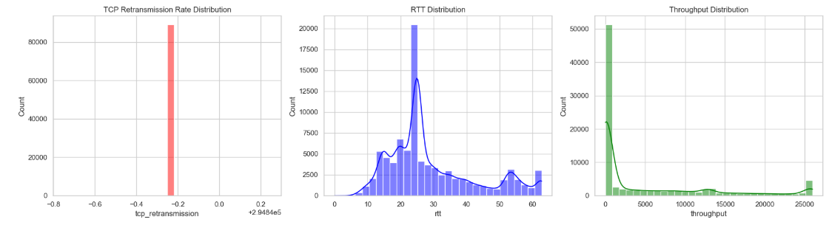
Experience Analysis by Handset Type
Key Metrics Analyzed:
TCP Retransmission Rate (indicator of network reliability)
RTT (Round Trip Time) (indicator of latency)
Throughput (indicator of speed/efficiency)
Summary Statistics:
Top Values: Identify handset types with highest average throughput and lowest retransmission rate.
Bottom Values: Handsets with worst performance (e.g., high RTT, low throughput).
Most Frequent (Mode): The most commonly used handset types and their experience quality.

Slide 12
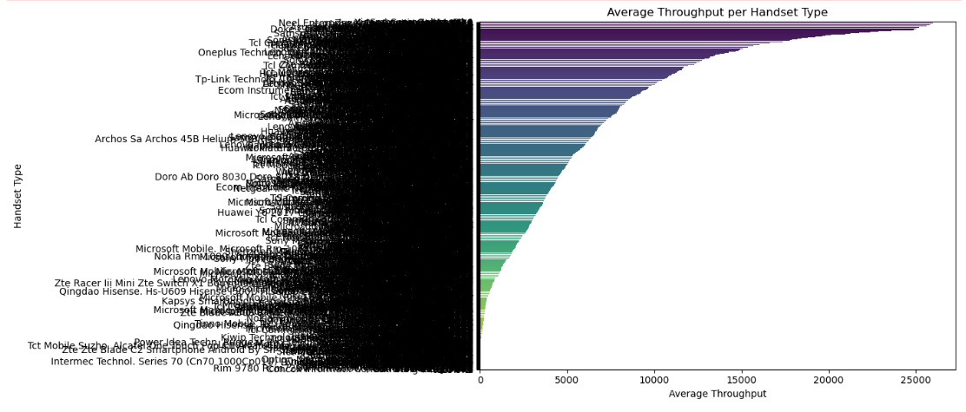
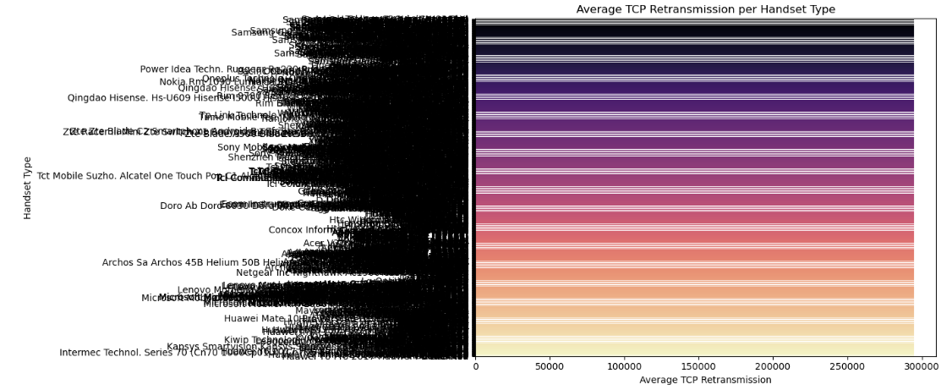
Experience Analysis by Handset Type

Slide 13
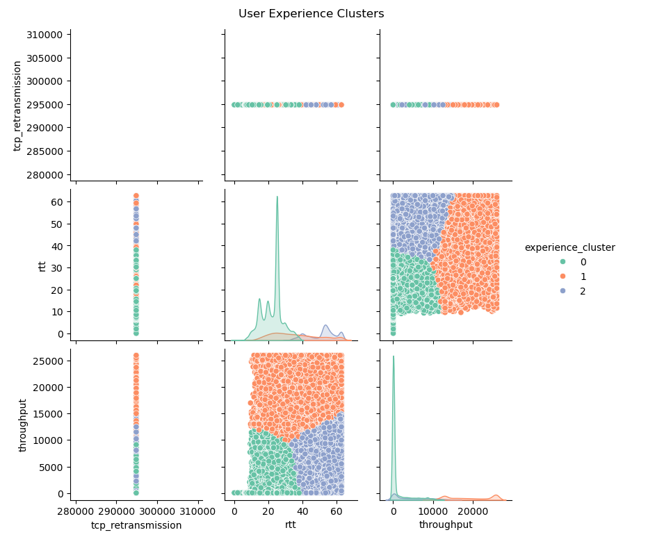
Experience Clustering (k=3)
A pairwise scatter matrix visualizes user segmentation based on experience metrics:
Axes: RTT, Throughput, and TCP Retransmission Each scatter plot cell shows two metrics, with clustering boundaries visible.
Key Insight:
Clustering users based on experience metrics reveals performance.
diversity: Enables targeted optimizations (e.g., improve RTT for Cluster 1).Helps recommend better handsets or plans for poor experience users. Can be used for personalized marketing, retention strategies, or technical support prioritization.

Slide 14
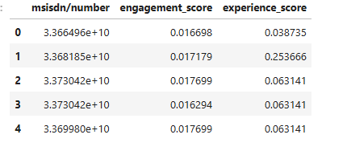
Engagement & Experience Scores
User Engagement & Experience Metrics
Euclidean Distance Approach Satisfaction Score is computed using the Euclidean distance to the ideal point (maximum engagement & experience).

Slide 15
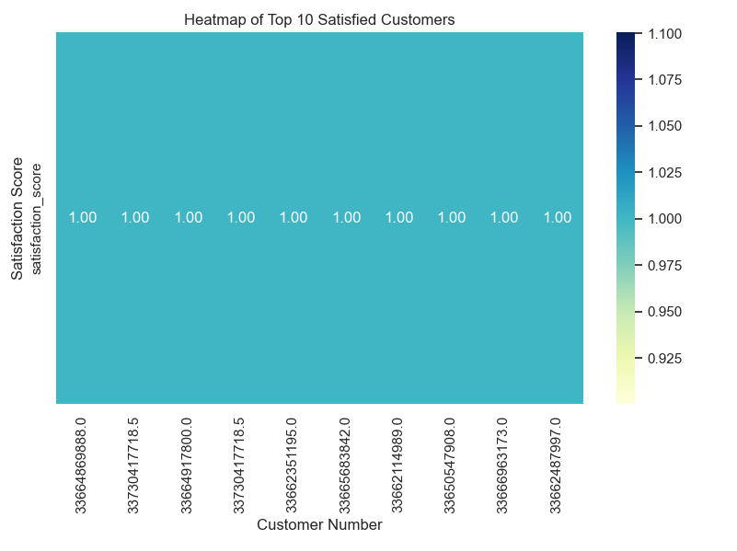
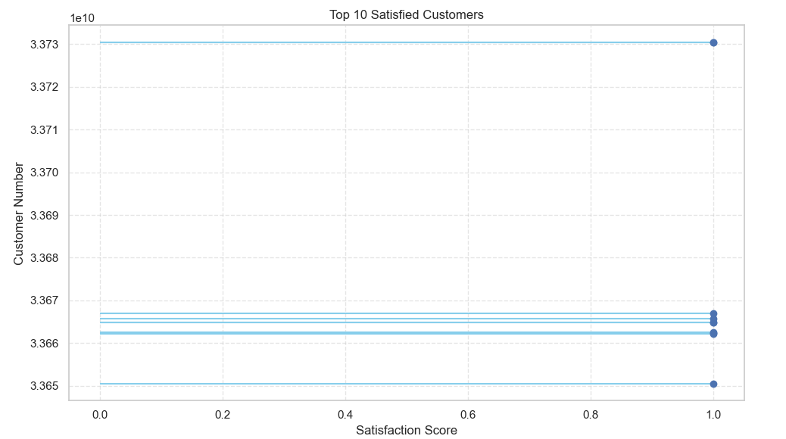
Satisfaction Score Visualization

Slide 16
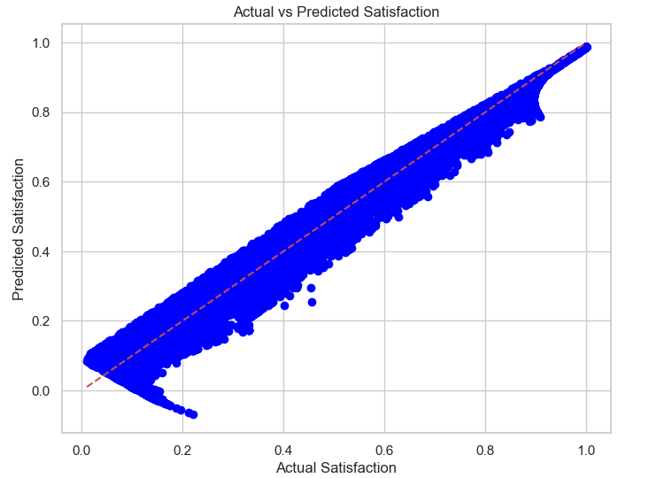
Regression Model to Predict Satisfaction
0.9538
0.9538
Linear Regression Results
Model Summary:
R² = 0.9538
MAE= 0.0490
Scatter Plot: Actual vs Predicted
The scatter plot demonstrates a strong linear trend.
The red dashed line represents the ideal 1:1 match between actual and predicted values.
Deviation mostly occurs at the lower and upper extremes of satisfaction.

Slide 17
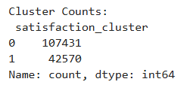
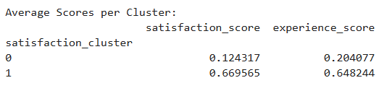
K-Means on Satisfaction (k=2)
Clustering Users by Satisfaction Behavior
Clustering Algorithm Used:
K-Means with k = 2
Features: Engagement Score, Experience Score
Cluster Assignment Logic:
Users were grouped based on behavioral similarity.
Each cluster reflects a distinct satisfaction profile:
Cluster 0: High engagement & experience (closer to “ideal”)
Cluster 1: Lower satisfaction (less engaged or experienced)

Slide 18
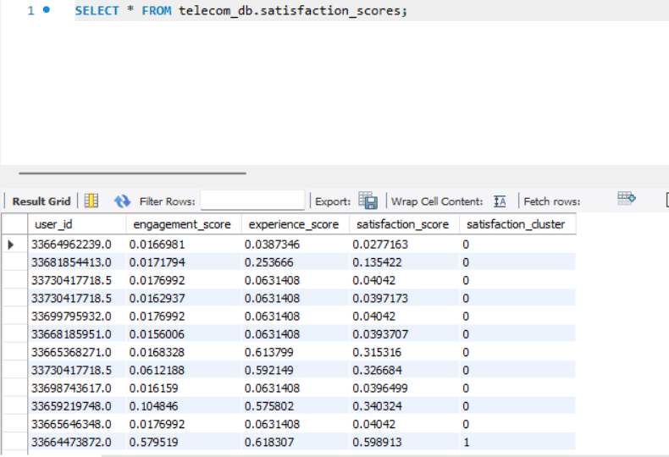
Data Export to MySQL
Database Export for Scalability
MySQL Export:
Satisfaction analysis table exported for further analytics.
Screenshot of the MySQL table showing structure and sample data.

Slide 19
Summary of Findings
Key Observations:
Satisfaction closely tied to both engagement and experience.
Higher satisfaction found in users frequently using:
YouTube, Social Media, Streaming apps
Poor device performance linked to reduced experience and satisfaction.

Slide 20
Thanks

